Slide 1

Passive Safe Integral LWR Option for Accelerating
Nuclear Capacity Building
A.K. Nayak
Outstanding Scientist
Bhabha Atomic Research Centre
Trombay, Mumbai, India
Email: arunths@barc.gov.in

Slide 2
Current Indian energy scenario
360 GWe: The total installed capacity for electricity generation in the country
63.0 %: percentage of thermal power plants of the total installed capacity in the country, with an installed capacity of 227 GWe
Source:https://npp.gov.in/public-reports/cea/monthly/installcap/2019/AUG/capacity1-2019-08.pdf

Slide 3
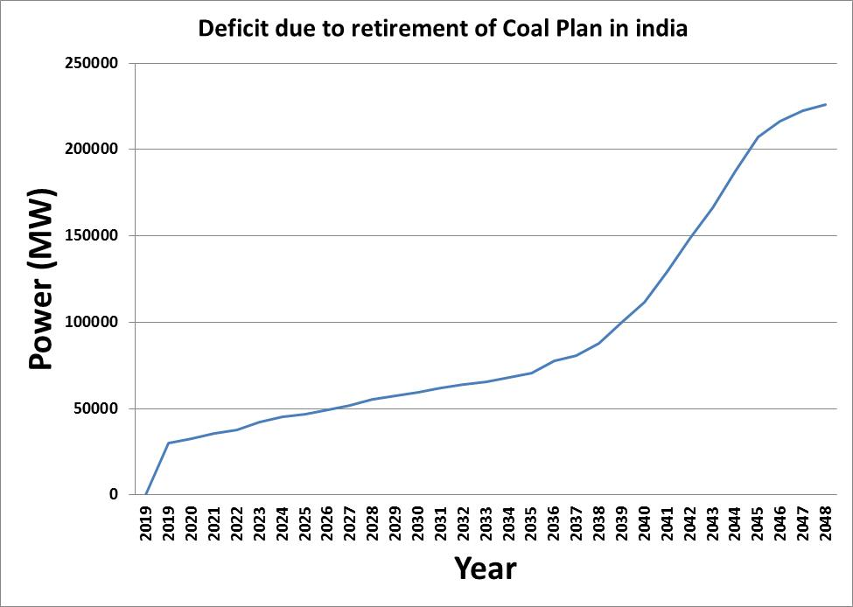
The Indian energy scenario and concerns of retiring coal plants
By 2050, most of the existing coal plants are projected to be retiring (Approx 200 GWe) considering their design life of 30 years without extension).
Source: CENTRAL ELECTRICITY AUTHORITY http://cea.nic.in/reports/others/planning/pdm/list_power_stations_2019.pdf
Year wise retirement of coal plants - projected

Slide 4
The Indian energy scenario and concerns of retiring coal plants
Additional coal plants cannot be built due to concerns and pressure globally to reduce the emission of greenhouse gases due to immense use of carbon based fuel.
In this context, India submitted its Nationally Determined Contributions (NDCs) to the United Nations Framework Convention on Climate Change (UNFCCC) in Paris
  to reduce the emissions intensity of Gross Domestic Product (GDP) by 33–35% of 2005 levels by 2030.
  40% fossil-free power generation capacity to be achieved by 2030
  Creation of additional carbon sink of 2.5 to 3 billion tonnes of CO₂ equivalent (CO₂eq).
This requires replacement of retired coal plants by clean energy sources
Source: CSTEP (2018), Roadmap for achieving India’s NDC pledge, (CSTEP-Report-2018-08)

Slide 5
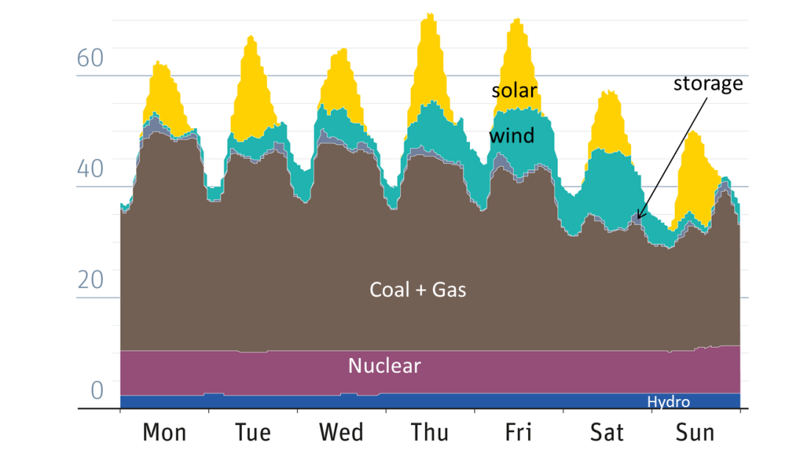
So what is going to replace them?
Solar ??
  energy density small (so large area requirement^{)*;}
  capacity factor currently around 25 %; intermittent,
  life 15 to 20 years;
Wind ??
  capacity factor around 35 %; intermittent,
  solar or wind can only be utilised as a load sharing source and not as the base load source of energy
GWe
* Land-Use Requirements for Solar Power Plants in the United States, Technical Report NREL/TP-6A20-56290,2013.

Slide 6
The role of nuclear power in addressing the imminent threat of climate change
Nuclear?
  High energy density;
  capacity factor ~ 90%;
  Avg. 0.7 Acres/MWe including exclusion zone
  life 60 years;
  large international experience in proven technology of LWRs
Hence, nuclear energy must be considered in energy mix as a base load source of clean energy

Slide 7
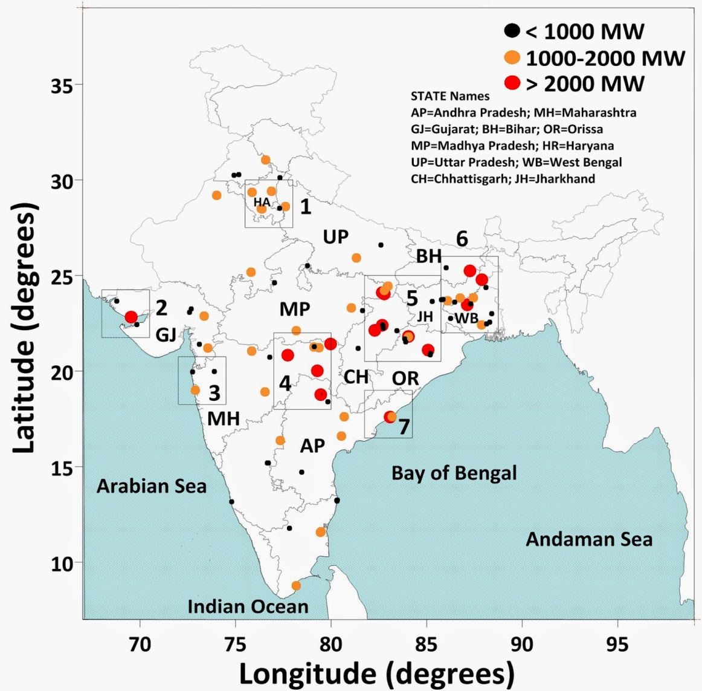
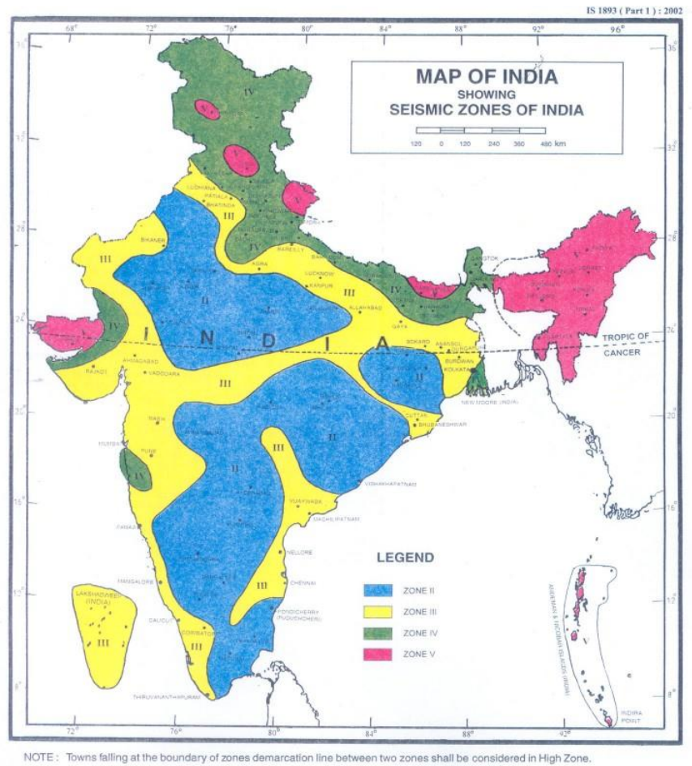
Coal plants locations
Seismic Zones
India Coal Fired Power Plants 2013
http://www.urbanemissions.info/india-emissions-inventory/emissions-in-india-coal-fired-power-plants/
MINISTRY OF EARTH SCIENCES
LOK SABHA UNSTARRED QUESTION No. 2046
Conclusion of this map comparison: Majority of the coal power plants are situated in zone II; and some are in Zone III. Hence, they can be easily replaced by nuclear plants.

Slide 8
Year wise Capacity Addition of coal plants with their size
Most of the coal plants are of small capacity, ranging from small size to even less than 250 MWe. BoP of these small size coal plants can be utilised for small NPPs.
Source: CENTRAL ELECTRICITY AUTHORITY http://cea.nic.in/reports/others/planning/pdm/list_power_stations_2019.pdf

Slide 9
The urgency for quickly augmenting nuclear generation capacity in the post-Paris scenario
Currently, the technology development for the first stage has matured.
18 PHWRs with installed capacity of 4460 MWe are in operation
To increase the capacity building, NPPs with LWR technologies are being built with foreign co-operation.
This process has facilitated import of fuel and fuel security for Indian NPPs from foreign sources through international civil nuclear cooperation agreement.

Slide 10
The urgency for quickly augmenting nuclear generation capacity in the post-Paris scenario – Requirements of new technology
Nuclear power is yet to augment for large capacity building.
In order to replace the coal plants , large capacity building from nuclear must be achieved within short span (2 to 3 decades).
Currently, AERB prescribes strict guidelines for siting of the nuclear plants. Considering the geology and population density of India, this poses limitations to the availability of large number of sites for construction of nuclear power plants as per the siting criteria of AERB with the current technology.
In order to augment large capacity building by replacing large number retired coal plants, a new concept of passive safe integral LWR (PSIR) is presented here.
PSIRs are inherently safe and can be built in retired coal plants”.

Slide 11
Important Aspect
In addition to the highest level of safety, technology of these reactors is such that
can be easily manufactured with short construction period,
ease in multiplication,
operated domestically
so as to enhance the capacity building (several hundreds of these reactors) within short period of 3 decades.

Slide 12
Passive Safe Integral LWRs (PSIRs) – an innovative small modular PWRs for accelerated capacity building
PSIRs are advanced PWRs that typically produce electric power of 150 MW(e) (2x150 MWe can be connected to one turbine). These plants are to be built in factories and shipped to sites for installation.

Slide 13
Passive Safe Integral LWRs (PSIRs) – an innovative small modular PWRs for accelerated capacity building
Why This Technology
Adopting proven LWR technology for power production: The LWR technology is more than six decades old and it is well proven. PSIR shall use the core configuration of standard LWR design. Thus, it will be an extension of India’s 1st stage nuclear power program.
Modularity in both manufacture and deployment: All components of NSS are housed inside the pressure vessel. Thus the PSIR is like a power pack. This will accelerate the capacity building in short time.
Flexibility in operation: Having several units of same size in one site, gives the flexibility of usage as per load demands.

Slide 14
Passive Safe Integral LWRs (PSIRs) – an innovative small modular PWRs for accelerated capacity building
Make-in India: All components of PSIR can be manufactured in India including the RPV for which the current hydraulic press and forging capability are available in domestic industries.
Short construction schedules: Fabrication of the integral reactor which comprises of major components can be made in centralized manufacturing facilities and will be directly transported by rail to the site for installation thus reducing lot of time for site related activities for installation.
Reduction in IDC: Because of reduction in construction times, the interest during construction (IDC) is substantially reduced. This makes it very competitive with large reactors where IDC is a major cost component due to large construction time delay.
Lesser investment with early returns: Because of short construction time, return from investment starts early. So investors will have large confidence.

Slide 15
Passive Safe Integral LWRs (PSIRs) – an innovative small modular PWRs for accelerated capacity building
Integral reactor module making it inherently safe: PSIRs are integral reactors which contain all major equipments like pressure vessel, steam generator, pressurizer and pump inside the reactor vessel and thus avoiding large coolant piping which practically eliminates LBLOCA.

Slide 16
Passive Safe Integral LWRs (PSIRs) – an innovative small modular PWRs for accelerated capacity building
Passive safety features making it “walk away safe reactor”:
  PSIRs have advantage of small core size which requires less amount of decay heat to be removed as compared to large reactors.
  This enables use of several passive safety systems in its design without leading to design extension conditions or core melt scenario.
  Thus, these reactors have potential to replace retired coal plants or other such industries without requiring new sites for construction.

Slide 17
Passive Safe Integral LWRs (PSIRs) – an innovative small modular PWRs for accelerated capacity building
Superiority over advanced reactors with passive systems:
  Current Gen III+ reactors also use several passive safety systems in their design.
  However, in these reactors, in extreme events resulting in multiple safety failures, core meltdown may also occur. Hence these reactors have provision for hydrogen mitigation and core catchers in their design.
  On the contrary, in PSIR, being small integral reactor with passive safety systems, clad surface temperature is always below the permissible limit in all postulated accidental conditions and hydrogen generation and core meltdown is practically eliminated in design under extreme conditions.

Slide 18
Passive Safe Integral LWRs (PSIRs) – an innovative small modular PWRs for accelerated capacity building
BARC has large experience in technology development and demonstration of passive safety systems
Harnessing benefits of international civilian nuclear co-operation agreement: The fuel for PSIRs can be imported under the international civilian nuclear co-operation agreement
Options for thorium burning

Slide 19
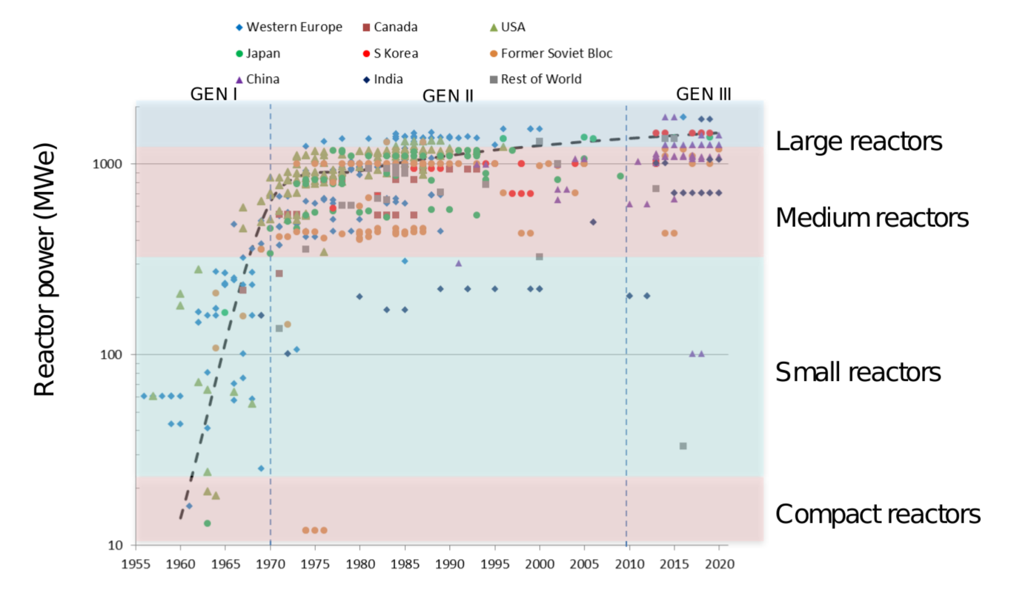
Why 150 MWe?
In the beginning there were only small reactors

Slide 20
Why 150 MWe?
Safety criteria for these plants are:
  400 deg.C for all plant conditions,
  no hydrogen production or core melt in extreme events
Indian forging capability for vessels is currently limited, which indirectly limits size of reactor.
The 150 MWe size reactor vessel weight is around 400 t which is possible for road transport for Indian conditions.
Integral reactor is like a product, easy to intsall and multiply.
Thus considering the safety, domestic manufacturing capability, transportation by road/rail, ease in installation and multiplication, 150 MWe plant is chosen.

Slide 21

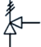
c
c
c
Passive aircooled condenser
c
c
c
c
c
c
Biological shield
Submerged containment
How PSIR Looks?
GDWP
IHX
Steam to turbine
Feedwater
Spent fuel pool
Internal re- circulation pumps
25 m
12 m
35 m

Slide 22
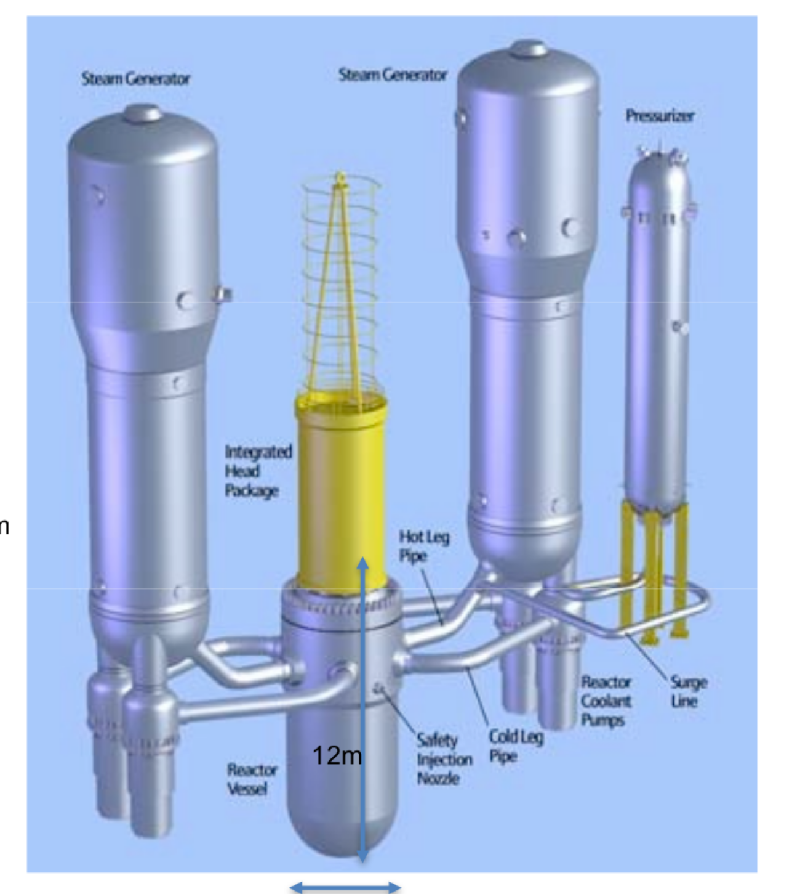
PSIR vs conventional PWR
Conventional PWR
PSIR
a product than
a project
20 m
3.3 m
4.4 m

Slide 23
PSIR: General Features
Reactor thermal output | 450 MWth
Design pressure | 17.0MPa
Design temperature | 350°C
Service life, in Calendar years | 60
Primary heat transport system
Primary coolant flow rate | 15,000 m³/hr
Reactor operating pressure | 15.0 MPa
Coolant inlet temperature, at RPV inlet, | 280 °C
Coolant outlet temperature, at RPV outlet, | 310 °C
Mean temperature rise across core | 30 °C

Slide 24
Core details

Slide 25
PSIR: Core Details
Reactor core
Rated thermal power | 450 MWth
No. of Fuel Assemblies | 37
Fuel material | UO2
Rated bundle power (per FA) | 12.16 MW
Core diameter | 1651 mm
Average linear heat rate, W/cm | 110.7
Average Thermal heat flux, W/cm­² | 38.76
Fuel assembly total length | ~4500 mm
Fuel pin Pitch | 12.75 mm
Burnable absorber | Gd mixed with fuel material
Enrichment, % | 4.9
Operating cycle length (fuel cycle length) | 18 months
Average discharge burnup of fuel | MWd/t 40,000

Slide 26
PSIR: RPV Details
Reactor pressure vessel
Cylindrical shell inner diameter | 3000 mm
Wall thickness of cylindrical shell | 160 mm (minimum)
Total height including SG | ~20,000 mm
Base material LAS forging | SA 508 class 3
RPV head, LAS forging | SA 508 class 3
Design pressure | 17.0 MPa
Design Temperature | 350 °C

Slide 27
SG details

Slide 28
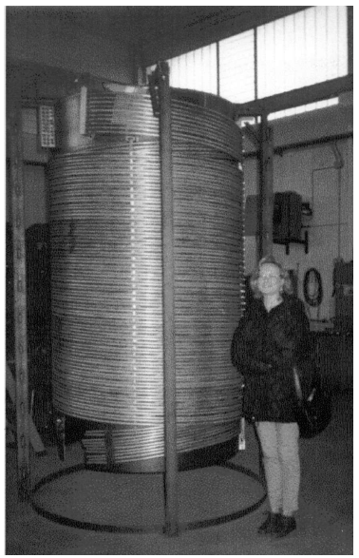
Details of Steam Generator
Steam pressure at rated power | 50 bar (450 MW)
Steam Temperature | 282ºC (superheated by 18ºC)
Feed water temperature | 203º
Feed and steam flow rate | 250 kg/s
Arrangement | Helical coil (secondary inside tubes) with 25 helix arranged concentric to each other.
Min. Helix dia. | 1.6 m (limited by core diameter)
Max. helix dia. | 2.8 m (limited by RPV ID)
No. of tubes | 2700
Tube OD | 17.46 mm
Tube ID | 13.24 mm
OTSG tube bundle length | 11 m (Total length, with headers will be somewhat more)
Helical coil OTSG

Slide 29
Containment

Slide 30
PSIR: Containment Design Basis
Steel Containment
Designed for peak pressure when steam comes out of RPV instantaneously during multiple SG tube rupture along with in-containment MSLB or POSRV stuck open
Containment volume calculated as required 1850m³ (12 m dia x 25m long) for 25 bar design pressure
Containment is submerged in water pool – initial cooling by natural convection of water followed by air cooling for infinity period.

Slide 31
Safety systems details

Slide 32
Design basis for safety systems of PSIR
Clad surface temperature below 400 °C at all plant conditions
Under extreme conditions, core is coolable by passive means even with air so that
  No hydrogen
  No core melt
  Thus, this reactor is designed with “walkaway safety” philosophy with no operator dependency on safety of reactor during any accidental condition.

Slide 33
Design features of PSIR for accomplishment of safety under all conditions by passive means
Design Target | Safety System | Accomplishments
Reactor Shutdown | Active shutdown system through shut-off rods for NO Passive Boron injection at high pressure in primary system during intentional malevolent actions | Reactor shutdown is ensured in all conditions eliminating RIA
SBO | Passive decay heat removal system through air-cooled condenser (Infinite SBO) 6 % capacity, total 27 MW | Decay heat removal ensured for infinite time period
Passive containment cooling | Steel containment with high pressure withstanding capacity (~25 bar) Passive containment cooling through steel containment submerged in 4000 m³ water (7 days) and subsequently by air for indefinite period | Containment pressure within design limit at all conditions
LB LOCA | Eliminated by design | Hydrogen production by metal water reaction avoided by design

Slide 34
Design features of PSIR for accomplishment of safety under all conditions
Design Target | Safety System | Accomplishments
SG Tube rupture | For single SG tube rupture, the required SG is isolated | Clad temperature below 400 °C, No hydrogen generation
SG Tube rupture with in-containment MSLB + NO ECC | Since containment is submerged in water, the steam is condensed, collected in sump surrounding RPV Heat sink is available surrounding RPV. Decay heat from core is removed by natural convection/radiation of steam/air mixture through vessel wall | No hydrogen generation

Slide 35
Passive Poison injection
c
c
c
c
c
c
c
c
c
Upon high pressure in pressurizer, the Passive Valve opens in the poison injection line and it opens the valve for injection of poison in reactor which shuts down the reactor.

Slide 36
Infinite SBO
c
c
c
Passive aircooled condenser
c
c
c
c
c
c
During SBO, heat load is removed by passive air cooled condenser
The condensate is sent back to RPV to maintain the circulation for infinite period
IHX

Slide 37
SG Tube rupture
Single SG tube rupture
In case of single tube/single bank in 1 SG, the affected SG is isolated.
Remaining 3 SGs can cater to the reduced load
SG tube rupture in multiple trains
If tubes are ruptured in upto 3 SG trains simultaneously, the reactor is shutdown and decay heat can be removed by a single SG
SG tube rupture in all 4 SG trains simultaneously

Slide 38
MSLB + multiple SGTR+ No ECC (worst possible accident)
c
c
c
c
c
c
c
c
c
  If all engineered safety systems fail, reactor still survives by natural circulation of air/steam within RPV.
  Maximum clad temperature is
    750 deg. C for 100 MWe,
    825 deg. C for 125 MWe and
    950 deg. C for 150 MWe plant.

Slide 39
Siting and economic considerations

Slide 40
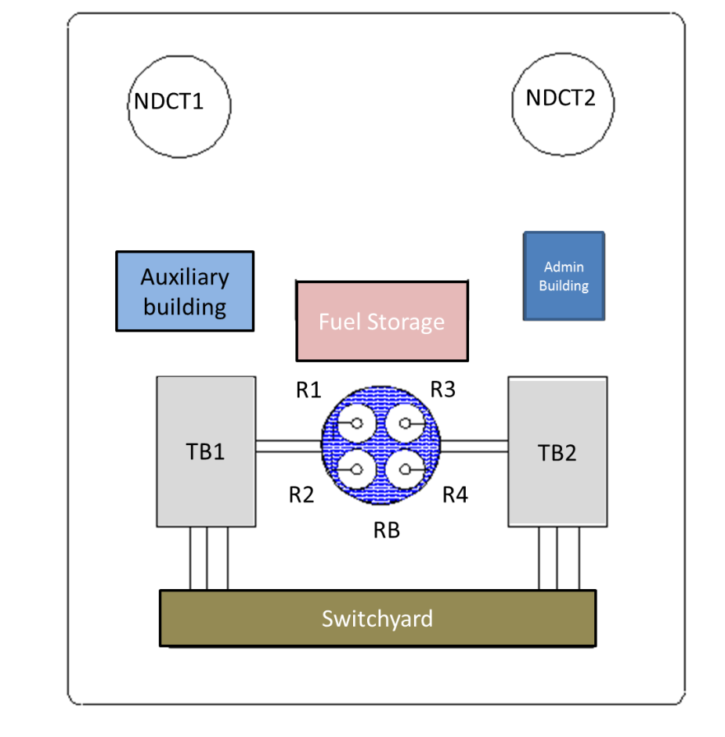
Siting considerations of PSIR
It is possible to replace retired coal plants by PSIR with existing AERB siting criteria for exclusion zone.
The first reactor can be built in an abandoned coal plant site which can fulfill AERB siting criteria.
Subsequently, it can be placed en masse in retired coal plants or other sites to take benefits of availability of infrastructure like water supply, switchyard, and rail connectivity (for transportation) etc.
Typical layout of 2 units of 2 x 150 MWe plant (200 m x 200 m)

Slide 41
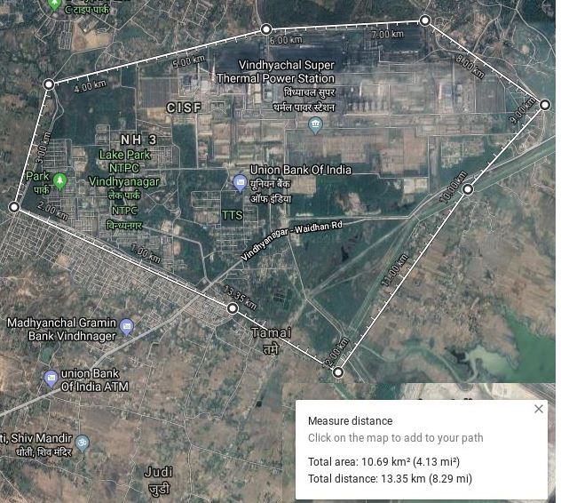
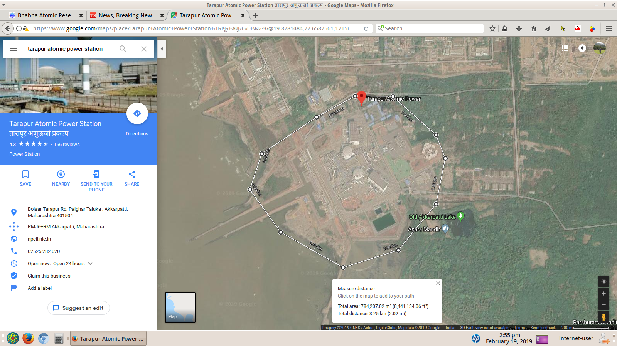
Land requirement: a comparison
A typical 3760 MWe Thermal Power Station occupies about
  10 km² area without ash pond (0.65 Acres/MWe)
  23 km² with ash pond (1.511 Acres/MWe)
Nuclear plant:
2 x 540 MWe (1080 MWe)
  0.8 km² area including reactor building, turbine building auxiliary building and other utilities ( 0.182 Acres/MWe)
  3 km² with exclusion zone (0.686 Acres/MWe)

Slide 42
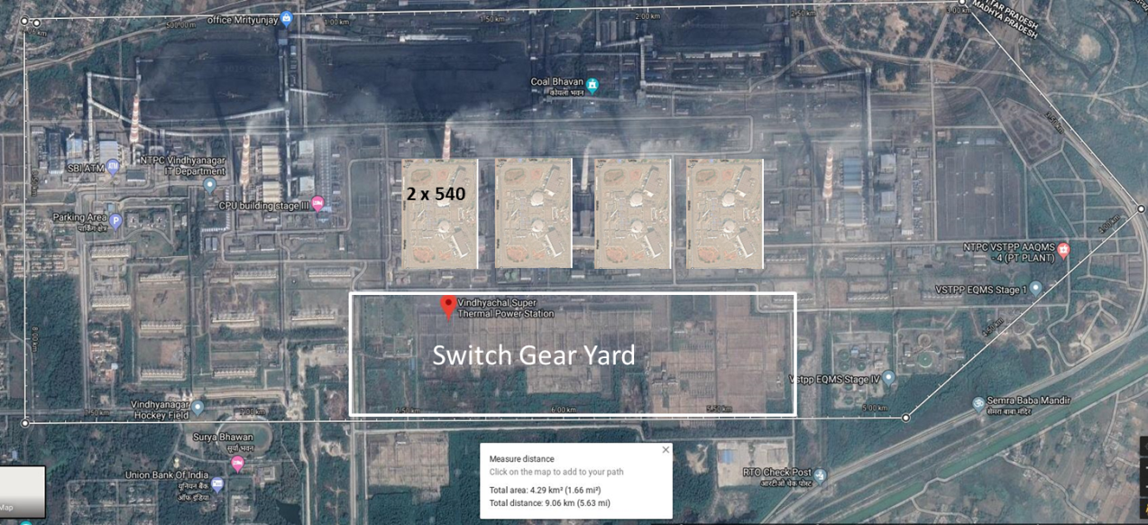
Land requirement: a comparison
Roughly 8 x (4 x150) MWe PHWRs (4800 MWe) can fit into the 3760 MWe coal plant (upon retirement) including the current criteria for exclusion zone

Slide 43
PSIR – Economics of scale
The economic benefits of PSIRs are primarily attributed to the following factors,
  cost saving for setting multiple units at same site,
  cost saving for site and programme learning for additional units in series,
  reduced IDC for shorter construction period,
  gradual capacity addition to meet demand
Estimated cost reduction in PSIRs because of benefitting factors

Slide 44
PSIRs shall create PWR revolution in India with several numbers to be built with large employment generation
It is expected that large numbers of PSIRs (several hundreds to replace coal plants) will be built in next two to three decades.
Drivers for growth of many other sectors (providing large employment opportunities) thus improving economics of the nation.

Slide 45
List of Contributors
A.K. Nayak
P.P. Kulkarni
M. Dhiman
P.K. Verma
A.K. Vishnoi
A. Dasgupta
P. Pandey
Mentors
Dr. R.K. Sinha, Former Chairman, AEC
Dr. S. Banerjee, Former Chairman, AEC
Shri S.A. Bhardwaj, Former
Chairman, AERB
Shri S. Singharoy, Dir (T), LWR, NPCIL
Shri G. Biswas, ED (Engg.), LWR, NPCIL
Shri P.R. Patil, AD, RDDG
Shri S.K. Sinha, Head, RED

Slide 46
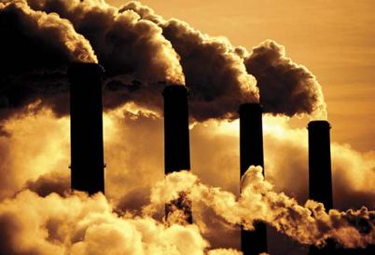
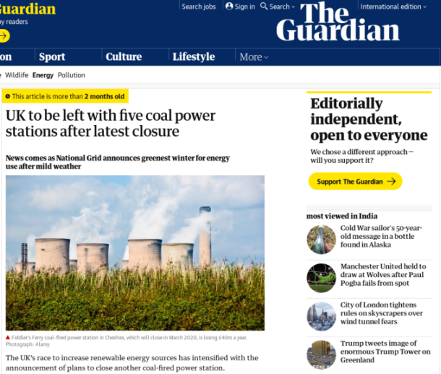



Flue-gas stack
Image Source : http://butane.chem.uiuc.edu/pshapley/environmental/l17/1.html

Slide 47
As a society, we must work for a safe and clean source of energy
Thank you

Slide 48
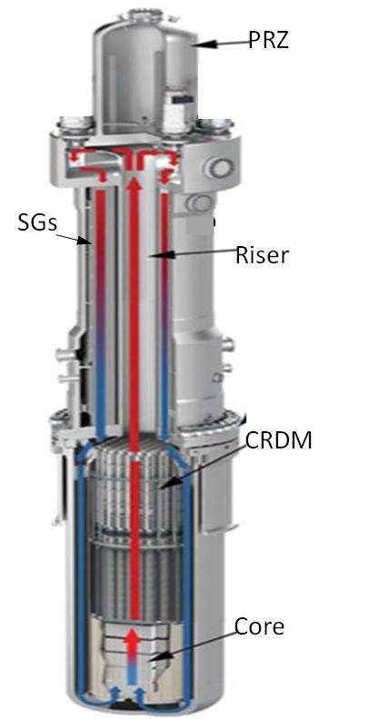
PSIR
A 3-D VIEW

